Slide 1
Evaluating Websites

Slide 3
WHO
Who Authored the Site?
Is He/She an Expert?
What Are the Credentials of the Author?

Slide 4
WHAT
Does the Site Have Relevant Information?
Is It Age Appropriate?
Is This Football??!!

Slide 5
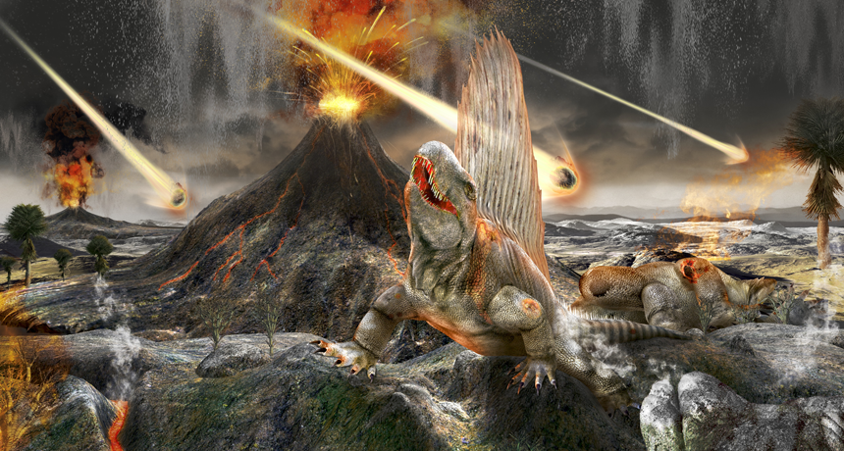
FOSSILS By Thomas Sumner
January 31, 2017 at 7:10 am
What killed the dinosaurs?
New rocky evidence has been emerging about the dinos’ final days.
Below the turquoise waters of Mexico’s Yucatán Peninsula lies the site of a long ago mass murder. In a geologic instant, most of the world’s animal and plant species went extinct. Drilling through
hundreds of meters of rock,
investigators have finally reached the “footprint” left by the accused. That footprint marks Earth’s most notorious space rock impact.
Known as Chicxulub (CHEEK-shuh-loob), it’s the dinosaur killer.
The asteroid impact that caused a massive global extinction event can be found on the coast of Mexico.
When Was the Information Published?
Is the Information Current?
Is Date Important?

Slide 6
WHERE
Where Does the Information Come From?
Has it Been Verified or Reviewed?
Does it Seemed Biased??

Slide 7
WHY
What is the Purpose/
Sell?
Inform?
Sometimes – Hard to Tell
What is the Purpose?
Sell?
Inform?
Sometimes – Hard to Tell

